Slide 1
Customer Support Chatbot With ML
PIP2001 Capstone Project
Review- 3
Batch Number: 168
Under the Supervision of,
Mr Asad Mohammed Khan
Assistant Professor
School of Computer Science and Engineering
Presidency University
Roll Number | Student Name
20211CSE0354 | Naveen Kumar M
20211CSE0369 | Mahmadkaip R S
20211CSE0383 | Mohan S G
20221LCS0013 | Madhu K
Name of the Program: CSE
Name of the HoD: Dr.Asif Mohammed
Name of the Program Project Coordinator: Mr.Amarnath JL/Dr.Jayanthi K
Name of the School Project Coordinators: Dr. Sampath A K / Dr. Abdul Khadar A / Mr. Md Ziaur Rahman

Slide 2
Content
Introduction
Literature Review
Proposed Method
Objectives
Methodology
Software Components
Timeline of the Project
Expected Outcomes
Algorithm
OutPut
Conclusion
References

Slide 3
Introduction
In customer support, chatbot by using machine learning customer can converse by a chatbot and acquire the query intent information.
With the enhancement of globalization and industrialization, it becomes a problem for enterprises to interact with the customer and listen to their difficulties to a big extent.
Chatbots make ease the pain that the industries nowadays facing.
The aim of this chatbot is to support and reply to the client by giving him/her the relevant intent depending on the query request from the customers.

Slide 4
Literature Review
Sl.no | Title/Author/publisher | Advantages | limitations
1. | Choudhury, S. D. G., & Rahman, M. A. H. B, Customer Support Chatbot: A Survey, International Journal of Computer Applications-2019 | Comprehensive overview of existing chatbot architectures. Identifies various machine learning techniques for natural language processing. | Limited focus on specific implementation challenges. Lacks empirical data on user satisfaction.
2. | Ali, A. D. S. A. Z., & Al-Harbi, Artificial Intelligence in Customer Service: A Study of Chatbot, Journal of Business Research-2021 | Highlights the efficiency improvements in customer service . Discusses various AI techniques enhancing customer satisfaction. | Primarily theoretical with limited case studies . May not cover all industry-specific applications.

Slide 5
Literature Review
Sl.no | Title/Author/publisher | Advantages | limitations
3. | Hu, J. P., & Chen, C. T, Design and Implementation of a Customer Support Chatbot Using Machine Learning , IEEE Access-2020 | Provides a practical implementation framework ,Compares performance metrics with traditional systems. | Focus on a single implementation context may limit generalizability, Potential scalability issues not fully addressed.
4. | Asad, M. A. O., & Ali, Enhancing Customer Experience with Chatbot Systems: A Machine Learning Perspective, Journal of Customer Service-2022 | Explores user experience improvements through ML-driven chatbots , Includes empirical case studies with quantitative results. | Limited by the sample size of case studies , May not address multilingual or culturally specific challenges.
5. | Sharma, T. R. S. S. J. A., & Gupta, R. K, A Comparative Study of Chatbot Systems for Customer Support, Computers in Human Behavior-2023 | Provides a comparative analysis of various chatbot systems . Evaluates effectiveness based on user queries and responses. | Comparisons may be influenced by varying evaluation criteria . Focused on a narrow range of chatbot technologies.

Slide 6
Existing method Drawback
Limited Understanding: Chatbots are a handy tool to help with easy queries, but with more complex tasks, there may be the need for human intervention.
Maintenance and Updates: Chatbots require ongoing maintenance and updates to remain effective and up-to-date.
Predefined Scripts: Many chatbots have predefined scripts or decision trees, limiting their flexibility and adaptability, so if the query lies outside of this, there may be the need for a customer service assistant to help. Nevertheless, there are some tools to help widen conversations so that they aren’t as stringent, and this will improve as technology does.

Slide 7
Objectives
Automate Customer Interactions
Improve Response Accuracy
Enhance User Experience
Learn from Interactions
Scalability
User Feedback Loop

Slide 8
Methodology/Modules
The Proposed method consists of the following steps:
Step-1: Customer Query/Request: Customer types the phrase in the chatbox.
Step-2: Chatbot: It packs the data and responds to the customer and the phrase
sent to ML-NLP engine (ML-NLP).
Step-3: Machine Learning NLP engine (ML-NLP): Extracted user intent and
entities sent back to chatbot.
Step-4: Data Query Search Engine: Chatbot based on intent call upon services
using entity information to find data from database. And data is returned to the
chatbot

Slide 9
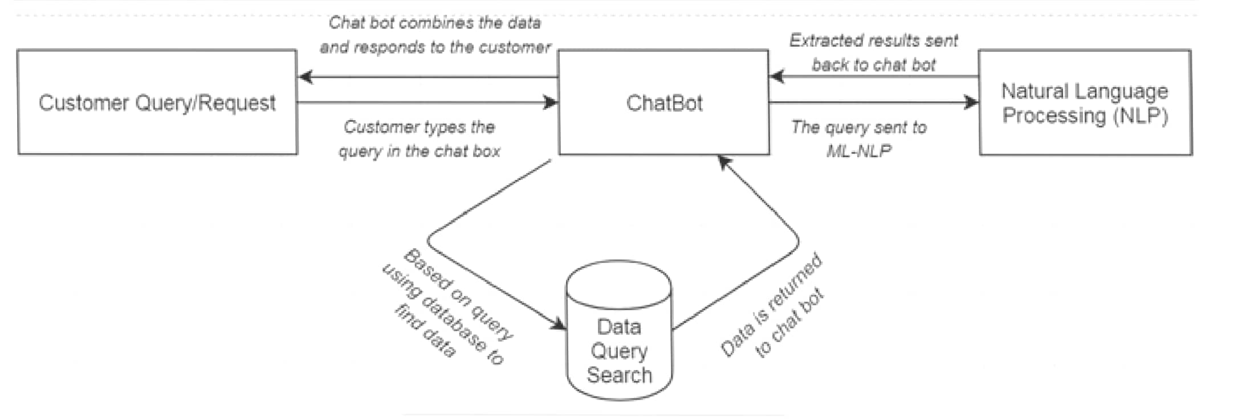
Architecture

Slide 10
software components
Software Requirements: Windows OS , Visual Studio ,
Html , CSS , Java Script for fronted.
Python ML Algorithms-NLP for backend.
SQL Database for storing the Queries.

Slide 11
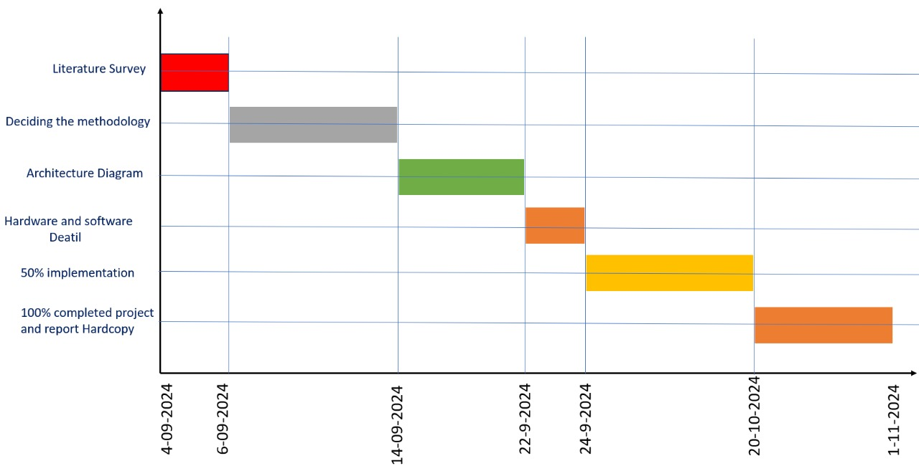
Timeline of Project

Slide 12
Expected Outcomes
Efficient Automation of Customer Service
Text inputs will be used by the chatbot to respond to queries.Smooth User Interface Accurate
Comprehension of user inquiries is ensured by Natural Language Processing (NLP).Customer satisfaction is increased by prompt responses and effective data retrieval . Feedback-Based Continuous Improvement
By gathering user input, the chatbot will guarantee frequent updates and increased precision . As new data becomes available, machine learning models will change over time . Greater Accessibility
For small and medium-sized businesses, the chatbot will be an affordable option . Using text, speech, input will boost user engagement for a variety of people.

Slide 13
Algorithm
#include <stdio.h>
#include <string.h>
1.Start
Scroll through the items
Add to cart
Buy
Step 2: Display the Homepage
if(chatbot is activated)
{

Slide 14
launch chatbot;
}
Step 3: Handle User Input
Ask the user for their choice
Read the user's input (choice).
Step 4: Chatbot Interaction
1.If the user selects Option 1:
Launch the chatbot.
Print: "Chatbot Launched.
2.Prompt the user to enter a question:
Print: "Enter your question:"
Read the user's input (query).

Slide 15
3.Initialize a variable found to 0 to track if the query exists in the database.
Step 5: Query the Database
1.Search for the user's query in the database:
Loop through the database (db) using a for loop.
If a match is found (strcmp(db[i].question, query) == 0)
Set found to 1.
Display the chatbot's response (db[i].response).
Break out of the loop.
2.If the query is not found (found == 0):
Print: "Chatbot Response: Contact Administration."
Add the unanswered query to the database:
Copy the query into db[db_size].question.

Slide 16
Set the response for this query as "Pending further investigation."
Increment db_size to reflect the new entry.
Print: "Unanswered query added to the database."
step 6:Loop
1.If a match is found (strcmp(db[i].question, query) == 0):
Set found to 1.
Display the chatbot's response (db[i].response).
Break out of the loop.
2.If the query is not found (found == 0):
Print: "Chatbot Response: Contact Administration."
Add the unanswered query to the database:

Slide 17
Copy the query into db[db_size].question.
Set the response for this query as "Pending further investigation."
Increment db_size to reflect the new entry.
Print: "Unanswered query added to the database."
Step 7: Close Chatbot or Exit Program
1.If the user selects Option 2:
Print: "Chatbot Closed. Exiting Program..."
Set running to 0 to exit the loop.
step 8: If the user provides an invalid input:
Print: "Invalid Choice. Please try again."
step 9:Exit the loop

Slide 18
Print: "Server Shut Down."
step 10: close the chatbot
else{
continue shopping;
}
END

Slide 19
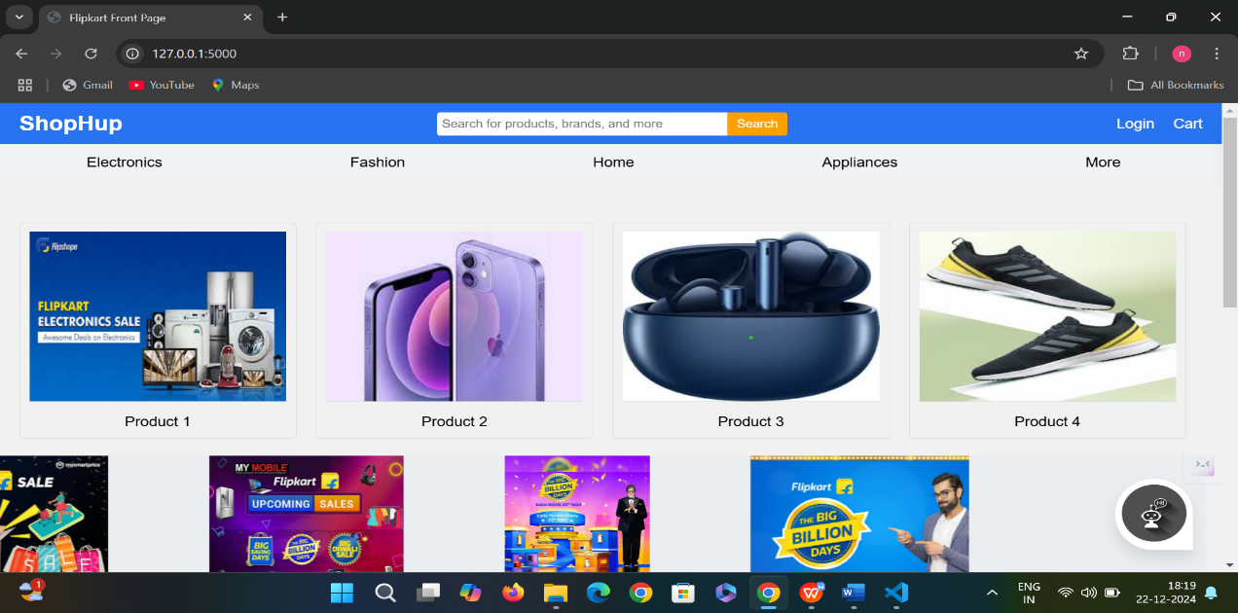
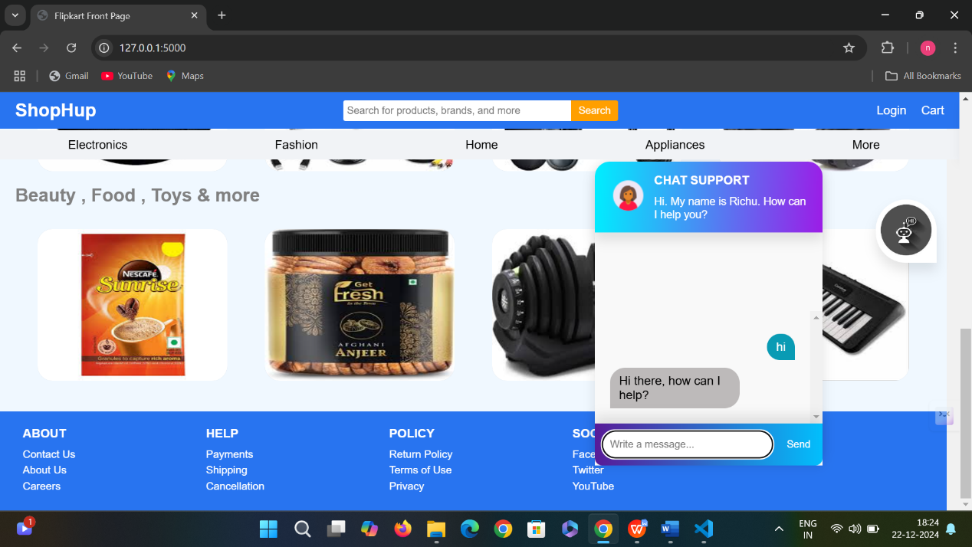
SCREENSHOTS
Fig 1.4 Display the home page
Fig 1.9 Chatbot response from the server side

Slide 20
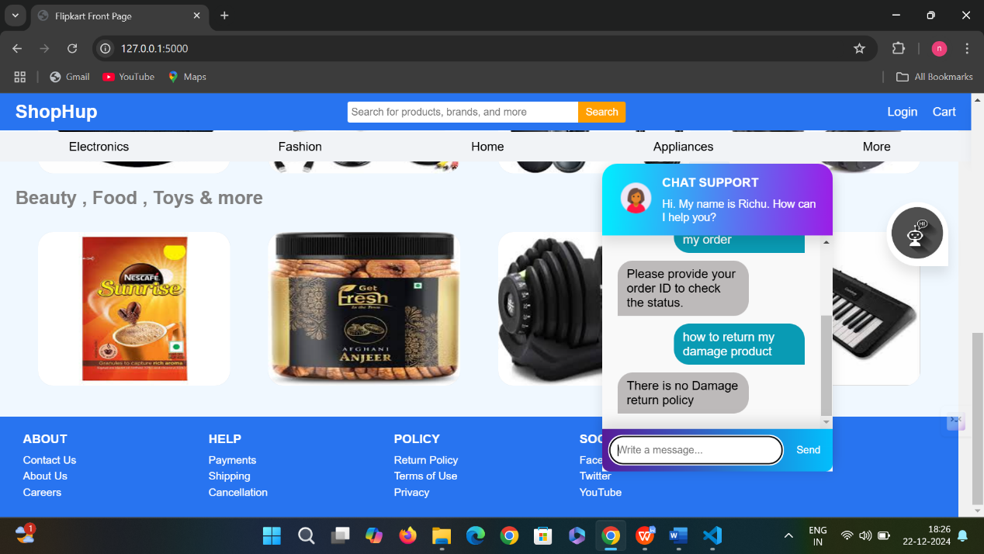
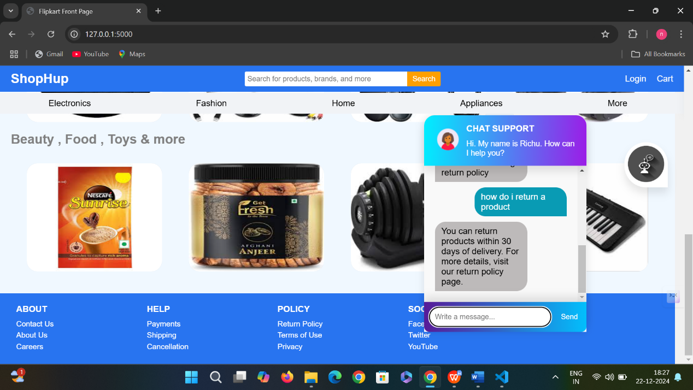
Fig 2.1 Query 2
Asking the query about product condition
Fig 2.2 Query 3
Asking information about return policy

Slide 21
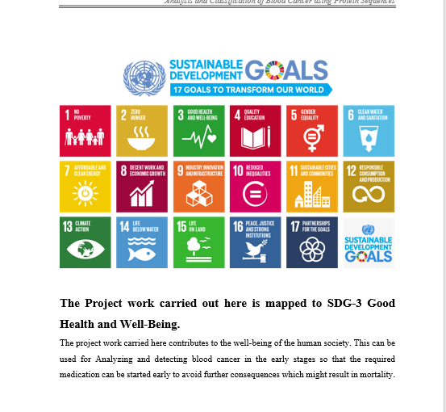
Project work mapping with SDG
The Project work carried out here is mapped to SDG-9
industry,innovation and infrastructure:
A chatbot can enhance business operations
and customer service efficiency through innovation.

Slide 22
Conclusion
The contribution is the development of a customer support chatbot using machine learning (ML) and natural language processing (NLP) in Python. While there are various chatbots available—both rule-based and self-learning—many are underutilized in the customer service domain. Rule-based chatbots tend to be rigid and struggle to comprehend the nuances of customer inquiries, such as context or slang. In contrast, self-learning chatbots utilize ML and NLP to understand and respond to diverse queries more effectively. This adaptability not only allows for immediate access to information but also enhances user satisfaction by providing personalized interactions. Moreover, these chatbots can operate around the clock, reducing wait times and freeing human agents to tackle more complex issues

Slide 23
Github Link
The Github link provided should have public access permission.
Github Link:
https://github.com/navii354/CUSTOMER-SUPPORT-CHATBOT-WITH-ML

Slide 24
References
Customer Support Chatbot Using Machine Learning https://www.researchgate.net/publication/343980800_Customer_Support_Chatbot_Using_Machine_Learning
Yordanov, V.: Introduction to NLP for text. https://towardsdatascience.com/introduction-to-natural-language-processing-for-text-df845750fb63
Customer Support Chatbot with ML Research paper https://www.ijrte.org/wp- content/uploads/papers/v8i1S3/A10170681S319.pdf
Ollama https://www.analyticsvidhya.com/blog/2023/10/a-step-by-step-guide-to-pdf-chatbots-with-langchain-and-ollama/

Slide 25
Thank You

